Slide 1
Lesson 10: Building Machine Learning Applications

Slide 2
Today's Agenda
End-to-End Machine Learning Process
Recap of ML algorithms
MACHINE BIAS
Model Interpretability
Cross-Industry Use Cases

Slide 3
Learning Objectives
Build and evaluate an end-to-end machine learning project

Slide 4
Machine Learning Everywhere
Machine Learning is increasingly applied across various industries to solve problems
Successful companies are moving more and more toward a data-driven culture, see this HBR article
Many internal and external stakeholders can be involved in a Machine Learning project

Slide 5
What to Look for in a Use Case
Who are the stakeholders? Who is my audience?
Direct and indirect measures and uncertainty around them
Choosing key metrics and benchmarks
Data collection, acquisition and preparation
Stating simplifying assumptions, constraints, granularity?
Are there ethical considerations that need to be addressed?
Technical aspects of the methodology (machine learning)
Technical aspects of the solution (operationalization)

Slide 6

CRISP-DM
Source: https://en.wikipedia.org/wiki/Cross-industry_standard_process_for_data_mining

Slide 7
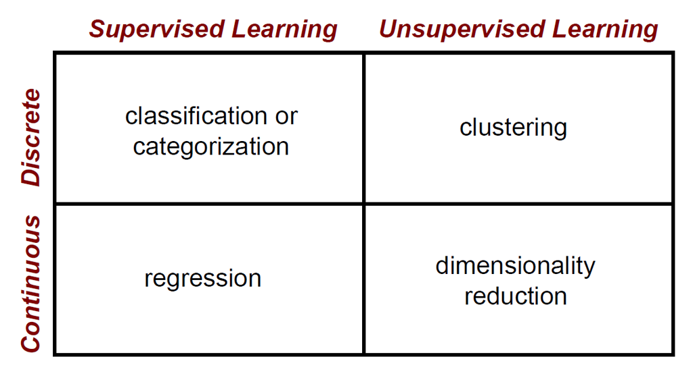
Machine Learning Problems

Slide 8
Clustering Strategies
K-means | K-mediods
Iteratively re-assign points to the nearest cluster center
Agglomerative clustering
Start with each point as its own cluster and iteratively merge the closest clusters

Slide 9
Machine Learning Problems

Slide 10
Classifiers: Nearest neighbor
Test example
Training examples from class 2
Training examples from class 1
f(x) = label of the training example nearest to x
All we need is a distance function for our inputs
No training required!

Slide 11
Classifiers: Linear
Find a linear function to separate the classes:
f(x) = sgn(w ⋅ x + b)

Slide 12
Classifiers: Linear SVM
x
x
x
o
x
x
x
o
x
x
o
o
o
o
x2
x1
Find a linear function to separate the classes:
f(x) = sgn(w ⋅ x + b)

Slide 13
Classifiers: Linear SVM
The kernel trick: instead of explicitly computing the lifting transformation φ(x), define a kernel function K such that K(x_{i} , x_{j}) = φ(x_{i} ) · φ(x_{j})
Φ: x → φ(x)

Slide 14
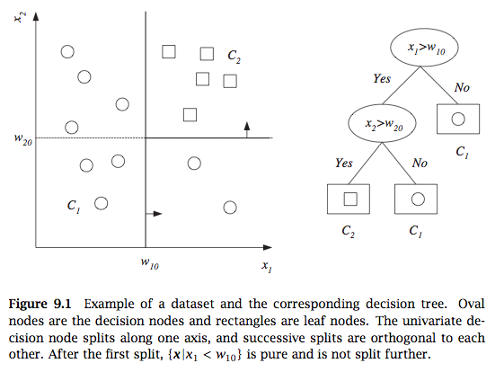
Classifiers: Decision Tree

Slide 15
Classifiers: Random forest
A single decision tree can overfit the data and have poor generalization (high error on test data). We can relieve this by bagging
Bagging
Randomly sample training data by bootstrapping
Determine classifier C_{i} on sampled data
Goto step 1 and repeat m times
For final classifier output the majority vote
Similar to tree bagging
Compute decision trees on bootstrapped datasets
Return majority vote
Alternative to bagging is to select datapoints with different probabilities that change in the algorithm (called boosting)

Slide 16
Machine Learning Problems

Slide 17
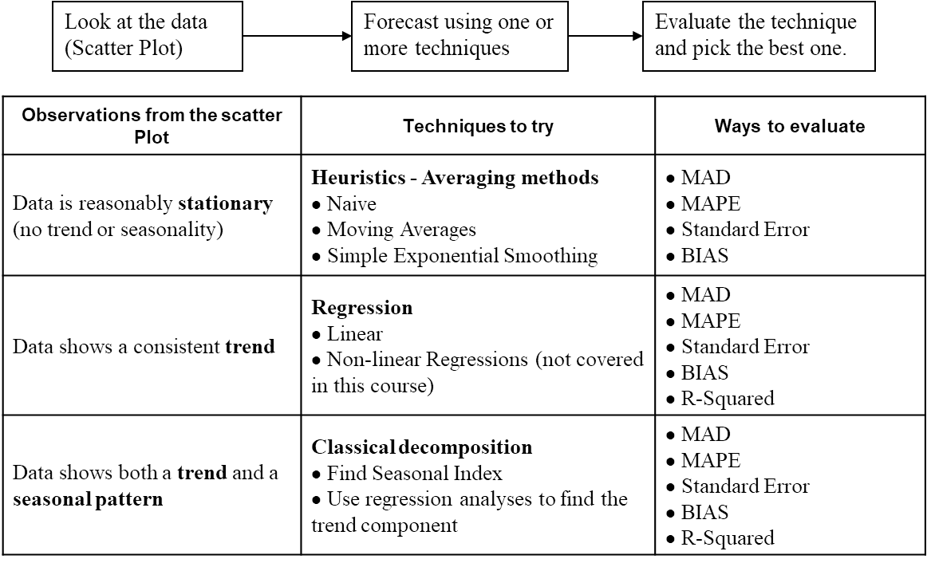
Time Series Forecasting Process

Slide 18
Machine Bias & Model Interpretability

Slide 19

Criminal Risk Scoring or How not to create Risk Scoring Systems
Why do we need Transparency, Accountability and Fairness in Machine Learning?
One way to achieve these goals is through embedding explanations in Machine Learning
Problems with the Criminal Risk Scoring System should be used as guides for other domains to not make the same mistakes
Arizona, Colorado, Delaware, Kentucky, Louisiana, Oklahoma, Virginia, Washington and Wisconsin use Criminal Risk Scoring systems in the Judicial System in the US

Slide 20
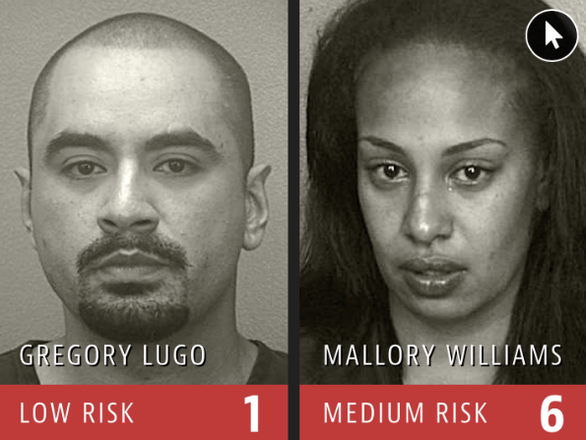
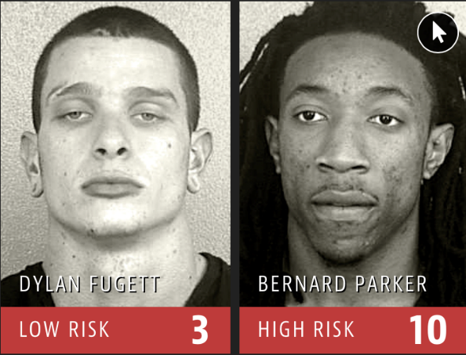
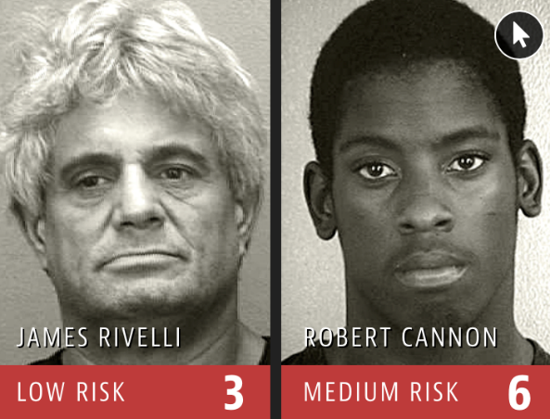

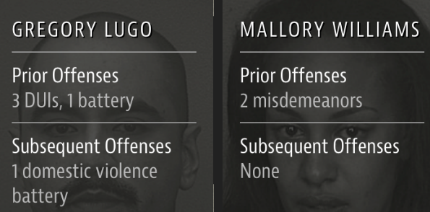
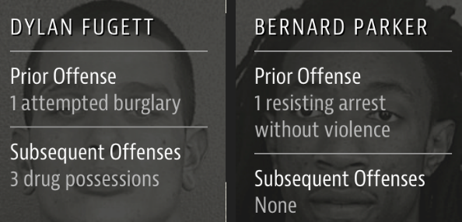
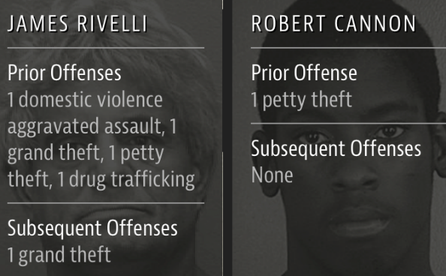
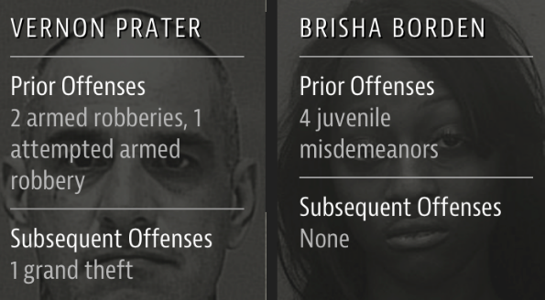
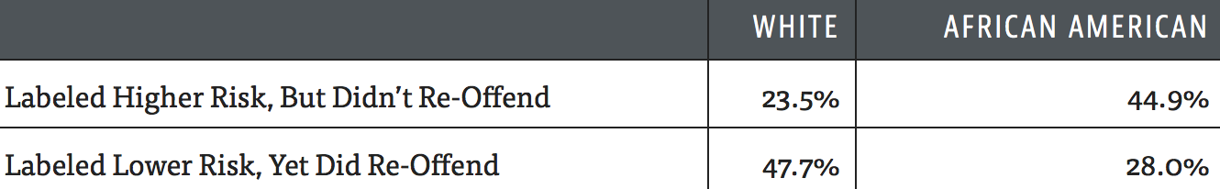
Bias in Criminal Risk Scoring Systems
(Source: ProPublica)

Slide 21

MACHINE BIAS
“Although these measures were crafted with the best of intentions, I am concerned that they inadvertently undermine our efforts to ensure individualized and equal justice, …. they may exacerbate unwarranted and unjust disparities that are already far too common in our criminal justice system and in our society.”
- United States Attorney General, Eric Holder 2014
Criminal Risk Scoring Systems
Northpointe (for-profit company)
Most widely used assessment tools in the country
Risk score calculation is not publically disclosed (proprietary)
Impossible for defendants to argue about bias that may be present in these systems.

Slide 22

ProPublica Study
Obtained risk scores of 7,000 people arrested in Broward County, Florida, in 2013 and 2014
Checked to see how many were charged with new crimes over the next two years (benchmark used by the creators of the algorithm)
The algorithm is better than random
61% of high risk offenders actually re-offended
Misclassification Problems
Falsely labeled black defendants as future criminals twice as many times as white defendants
White defendants were mislabeled as low risk more often than black defendants
https://www.propublica.org/article/machine-bias-risk-assessments-in-criminal-sentencing

Slide 23
LESSONS TO BE LEARNED
Don’t trust Arbitrary Scoring Systems unless they make domain sense
“A guy who has molested a small child every day for a year could still come out as a low risk because he probably has a job, Boessenecker said. Meanwhile, a drunk guy will look high risk because he’s homeless. These risk factors don’t tell you whether the guy ought to go to prison or not; the risk factors tell you more about what the probation conditions ought to be.” ProPublica
Even well-intentioned engineering can lead to adverse social effects
The effects of what we are seeing for Criminal Scoring Systems is not what its creators had intended
Need for open and fair systems in machine learning
Open and fair machine learning is needed in order to give additional information the users of machine learning so that such systems can be audited in case of a wrong assessment or prediction
Need to educate users of ML systems
Educate users of machine learning systems with respect to what the models are predicting vs. what they might think the system is doing (predictive vs. prescriptive vs. descriptive vs. causal models)

Slide 24
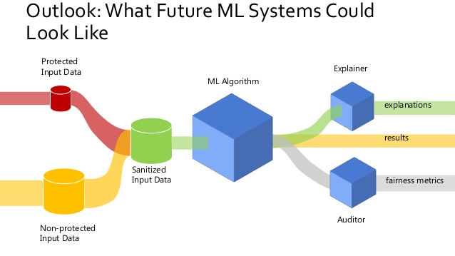
Source: Andreas Dewes

Slide 25
Need for Explanations in Machine Learning
Decision Making:
Why is the machine learning algorithm making a prediction?
What if the reasons for making the prediction are wrong?
Fairness:
Are different populations in the dataset being scored fairly?
Regulation:
GDPR’s right to explanation

Slide 26

Early History
Explanations and interpretability are currently at the cutting edge of ML
Many people assume that this a new topic
The earliest work in AI was rooted in logic to make mechanical reasoning transparent and easily understood
Logic Theorist (1955-56) could prove mathematical theorems given a problem
World’s first programmable Automata 12th century
The Al-Jazari orchestra, one of the earliest examples of known automatons. Credit: Freer Gallery of Art

Slide 27
Why do we need explanations now?
Machine Learning models have shown tremendous success in various prediction tasks
Availability of large amounts of data
Availability of cheap computing power
Ease of data collection
Deployment of ML systems in multiple domains

Slide 28
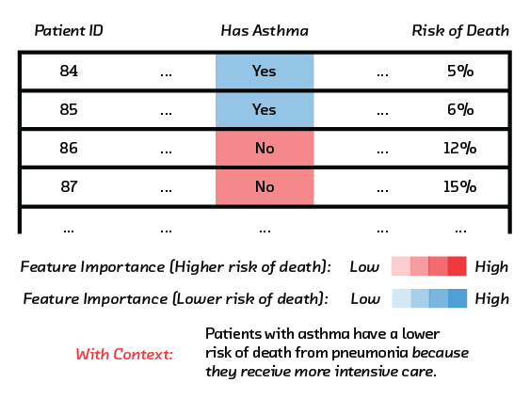
Need for ML Explanations
Case Study of Model with Erroneous Recommendations
Algorithms to predict which pneumonia patients should be admitted to hospitals and which treated as outpatients
Neural nets were far more accurate than classical statistical methods
However, it turned out that both the regression and the neural net had inferred that pneumonia patients with asthma have a lower risk of dying, and shouldn’t be admitted
But the opposite is true. Patients with asthma are high-risk. This was not captured in the data because asthma patients with pneumonia usually were admitted not just to the hospital but directly to the ICU, treated aggressively, and survived.

Slide 29

When is Model Interpretability Needed?
Any context where humans are required to provide explanations so that people cannot hide behind machine learning models
Where the decision based on the model predictions can have far reaching consequences, e.g., recommend an operation
Notes:
the admin responsible for staffing in ED is less likely to care about explanations in ED load prediction models. The exception is when there is rapid and massive change in the demand. In contexts where the premium is in accuracy (or other quantitative metric)

Slide 30
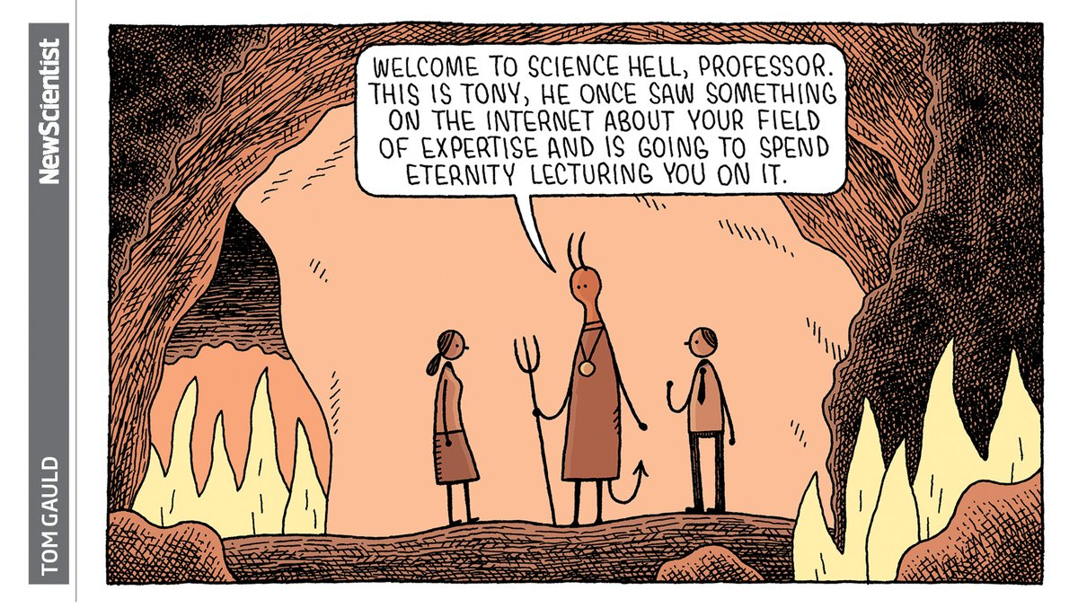
When are explanations not needed?
When are Contexts where Model Interpretability is not needed
Explanation Agnostic contexts, e.g., ED Staffing Prediction
Models which have shown to be highly effective empirically i.e., e.g., 98% accuracy for a diagnosis for the AI system
Systems that have theoretical guarantees on their performance

Slide 31
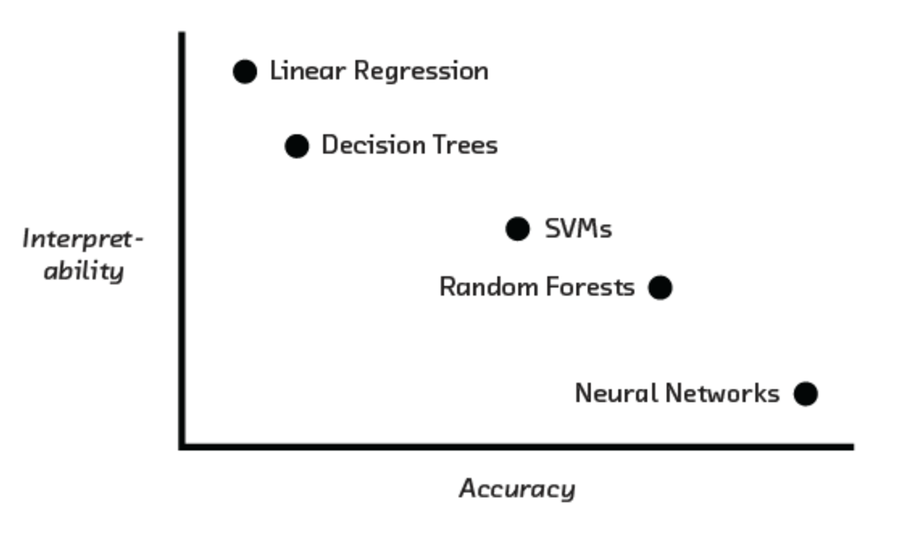

Accuracy vs. Interpretability

Slide 32

The Problem of Generalizability
Adrian Thompson (Sussex University) used neural networks to design circuits that could distinguish between 2 audio tunes
Resulted in a system with near perfect performance and fewer inputs than what humans use
Patterns picked up by the system were not generalizable
The algorithms can’t know which of those patterns exist nowhere else
The ML system was overfitting without realizing it

Slide 33
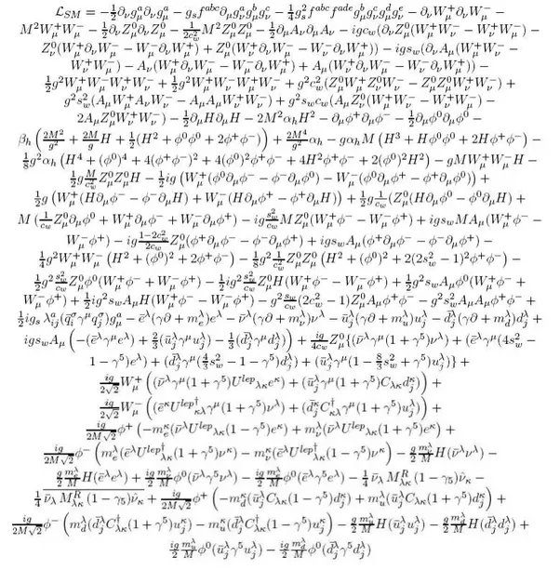
Defining Interpretable Machine Learning
Interpretable machine learning refers to giving explanations of machine learning models to humans with domain knowledge
Explanation: Why is the prediction being made?
Explanation to Human: The explanation should be comprehensible to humans in (i) natural language (ii) easy to understand
Domain Knowledge: The explanation should make sense to a domain expert
Standard Model Lagrangian

Slide 34
Limits of Explanations
“You can ask a human, but, you know, what cognitive psychologists have discovered is that when you ask a human you’re not really getting at the decision process. They make a decision first, and then you ask, and then they generate an explanation and that may not be the true explanation.”
- Peter Norvig

Slide 35
Desiderata for Interpretability in ML
Causality
The model can find causal links between variables and the outcome e.g., smoking and lung cancer. Note: Supervised Learning Algorithms learn associations which may not be causal.
Transferability
The results should generalize from the model building setting to the deployment setting even beyond issues related to overfitting e.g., be resistant to adversarial attacks.
Informativeness
Provide useful information about the model variables and the target
Fair Decision Making
Free from bias

Slide 36
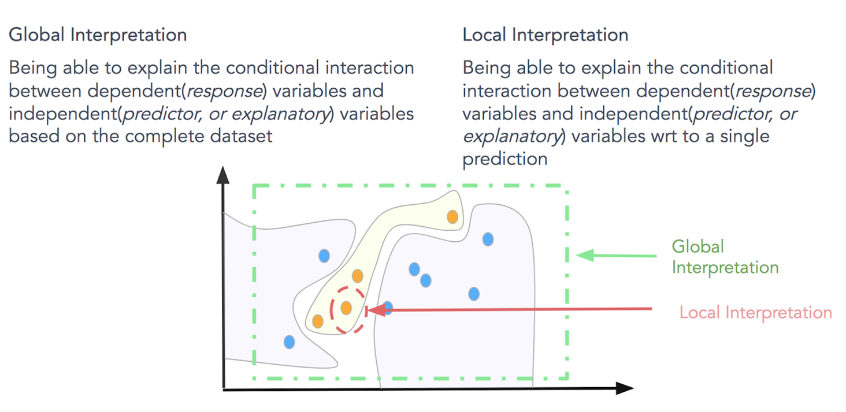

Global vs. Local

Slide 37
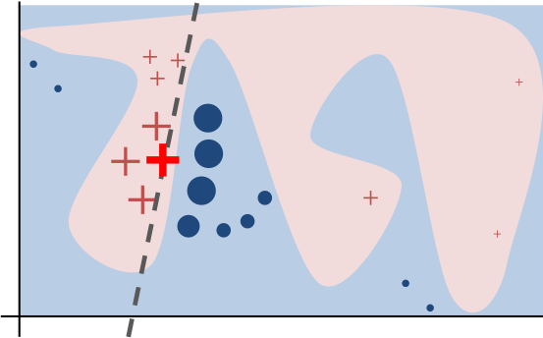
LIME
Locally Interpretable Model-agnostic Explanations
Given a non-interpretable model create local interpretable models that are good approximates of the data at the local level
The local model can be linear models like regression models
LIME simulates the distribution of the data locally
Can be problematic if the decision boundary is not linear locally

Slide 38
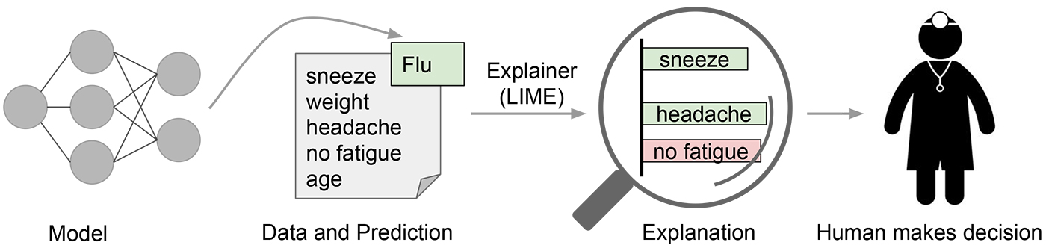
LIME: Model Explanations

Slide 39
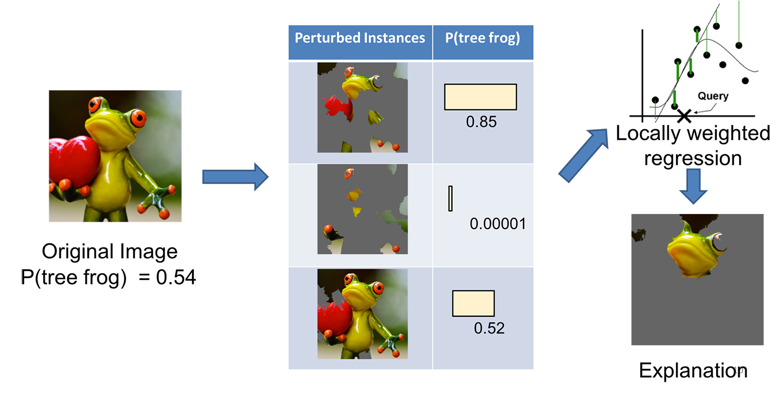
LIME: Explanations

Slide 40
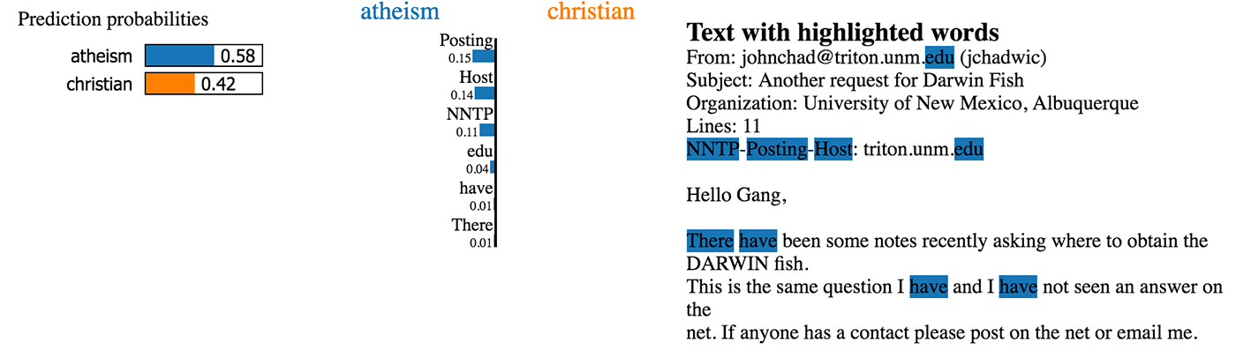
LIME: Explanations
Example of predicting the right label because of an artifact of the data

Slide 41
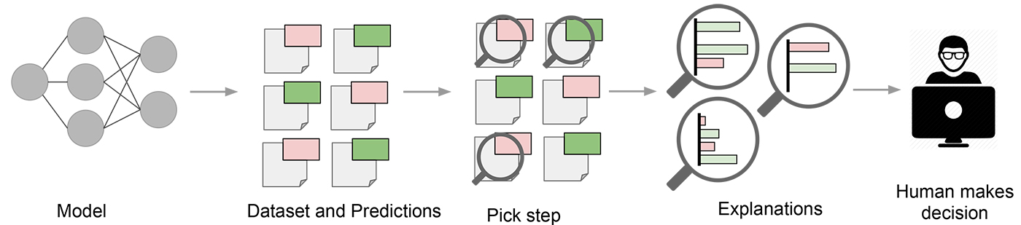
LIME: Explanation Actionability

Slide 42

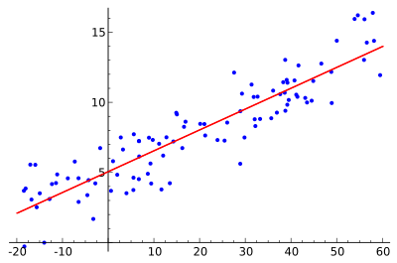
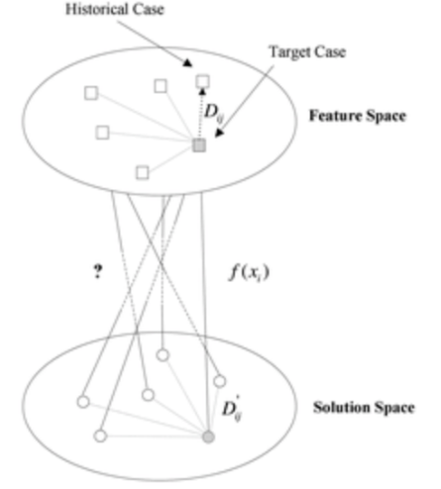
Taxonomy of Interpretable Models By Model Output
Rule Based Models
Relative Variable Importance
Case Based Models
A set of rules that describe how the prediction was made e.g., propositional rule learners, Bayesian rule lists, decision trees etc.
Linear models and related families of predictors that show relative importance and ordering of variables
Similarity function based models that use similar cases for prediction i.e., a prediction was made because this case looked like these k other cases

Slide 43
Taxonomy of Interpretable Models By Model Composition
First Order Models
Second Order Models
Models which have explanations built in as part of the model building process
Examples:
Decision Trees, GAMs, CENs etc.
Models that are built on top of black box models to provide explanations.
Local Models: LIME family of models, ASTRID, Random Forest Explainers,
Global/Student Models: Student models that train on model outputs of other models

Slide 44
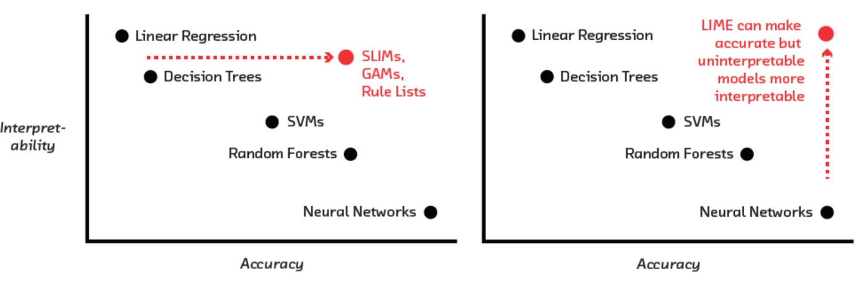

Accuracy vs. Interpretability

Slide 45
Feature Importance
Global feature importance values give an indication of the magnitude of a feature’s contribution to model predictions for all observations
Unlike regression parameters, they are often unsigned and typically not directly related to the numerical predictions of the model
Local feature importance describes how the combination of the learned model rules or parameters and an individual observation’s attributes affect a model’s prediction for that observation while taking nonlinearity and interactions into effect.

Slide 46
The Future: All AI Systems Explain Themselves
Given the proliferation of ML systems in healthcare and the potential impact on the lives of patients, the need for explanations will only increase
Only a matter of time before regulations comes to effect
Automation will bring greater scrutiny from practitioners
Lack of vigilance may lead to a ‘driverless car crash` moment in Ml in healthcare

Slide 47
Costco – Zero Waste

Slide 48

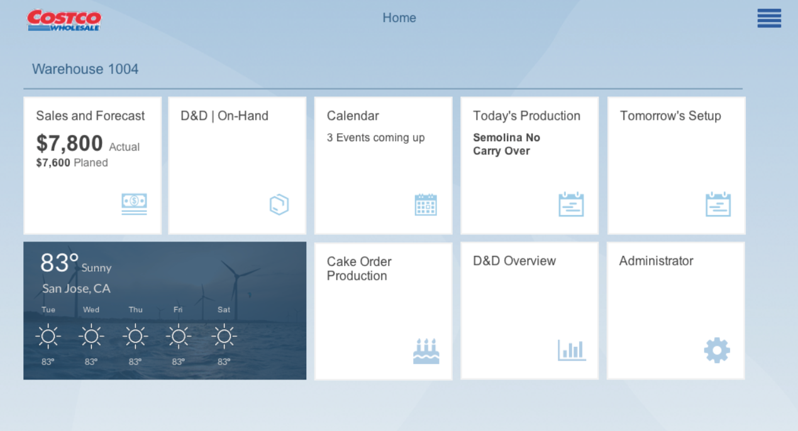
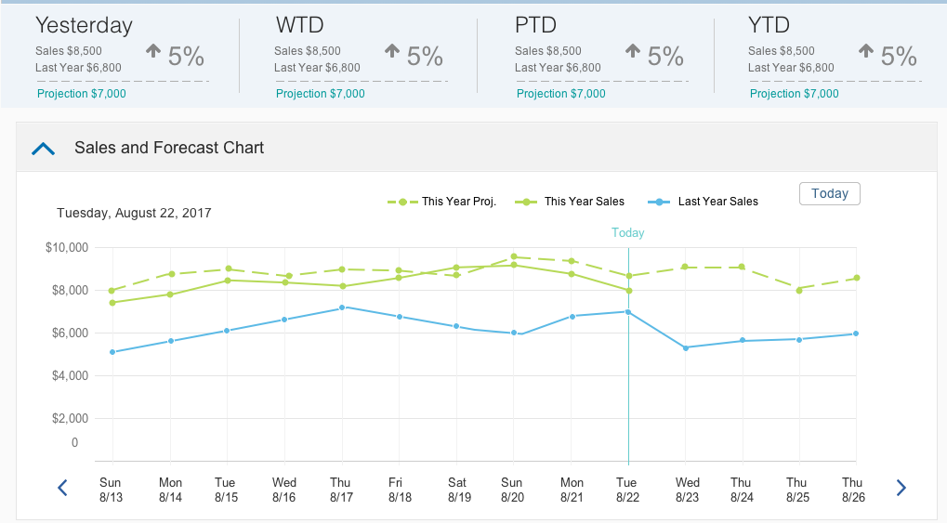
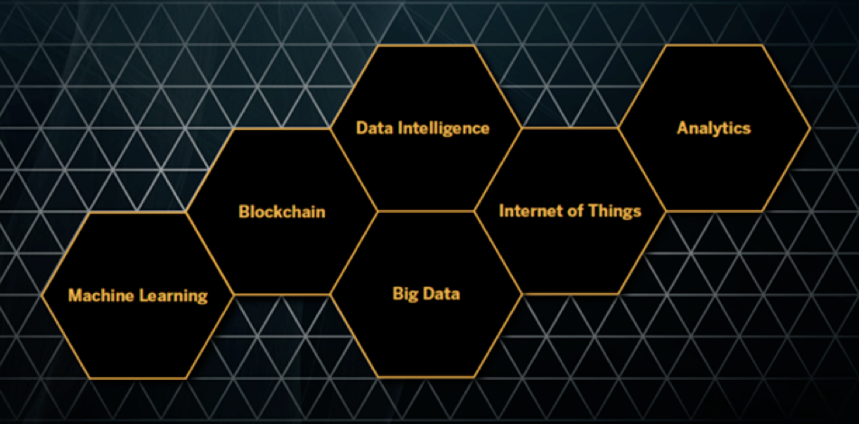
Costco – Bakery Zero-Waste
$129.03 bn
Annual Revenue
$2.68 bn
Net Profit
214,000
Employees
Results / outcomes / next steps:
Delivered application that
Provides visibility into daily sales and inventory
Proved a way to view and update warehouse events along with neighboring warehouse events.
Provided a daily demand forecast for each of the products to be sold on any given day based on weather, sporting events, holidays, pricing and seasonality.
Next: roll out the POC in two warehouses and monitor the efficiency it provides to the daily planning process.
Business Challenges and scope of collaborative prototype
Costco lose around $100MM in damaged and destroyed bakery items in north America. The daily planning of bakery items is critical to producing the correct quantity of products daily based on the consumer demand.
D&D has been on the rise at a 20% yearly rate, and the need to reduce it is critical.

Slide 49
Feature Decomposition – Butter Croissant
Notes:
- 33336 (BUTTER CROISSANT) at location 747 on 10/1/17 -> 10/4/17
- model not only show forecast but detail out the decompostion of the forecast
- The effects of 5 demand influencing factors contribute to the final forecasat number
- seasonality and weekofday component is driving the forecast, 10/1 is a sunday

Slide 50
Feature Decomposition – BRAIDED APPLE STRUDEL
BRAIDED APPLE STRUDEL (38521) on 07/10/2017
Notes:
- 38521 (BRAIDED APPLE STRUDEL) at location 148 on 7/10,
- PRICE is the major drive of the forecast, week of day effect is small
- (BG) first day of promotion, price reduces from 7.99 to 6.49 (as a price reduction/coupon took place on 7/10 to 7/23)
- (optional) actual sales is 85 (88) for location 148 and 38 (31) for location 747

Slide 51
Cost Savings After Zero-Waste
81%
69%
35%
66%
64%
52%
25%

Slide 54
Philips 66 - Predicting Emergency Shutdowns

Slide 55

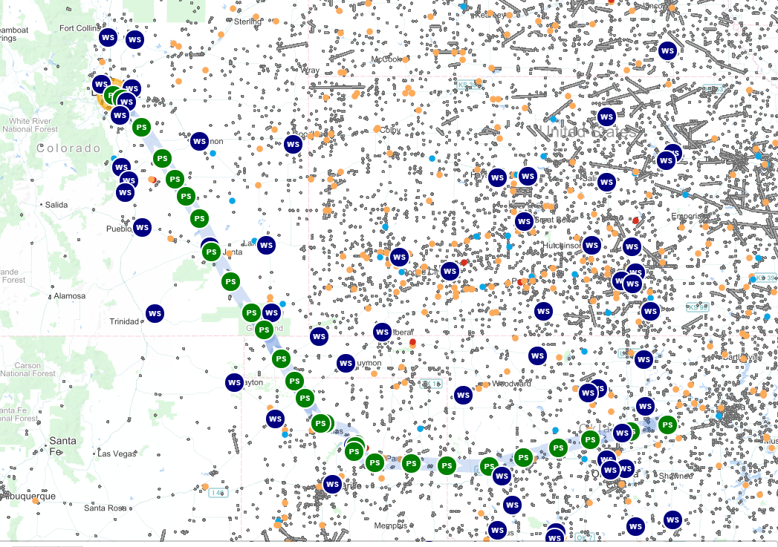
Phillips 66 – Eliminating Emergency Shutdowns (ESDs)
$87 bn
Annual Revenue
$4 bn
Net Profit
14,800
Employees
Executive Sponsors
Brian Ellebeck – VP Midstream
Zhanna Golodryga - CDO
Results / outcomes / next steps:
Delivered application that
Combines external weather and internal operational data providing unmatched insight to cause-effect
Proved the fit of SAPs HANA platform to intelligently combine very different data types/sources and deliver radical new insights in a intuitive UI
Determine the thresholds / predictive model that Phillips 66 can use as a preliminary warning system
Next: Extend the PoC to include more equipment performance data (OSI system). Also propose for P66 to invest in simple weather stations for each pump-station to refine predictive model further.
Identifying weather events causing pipeline pump-station failures
Business Challenges and scope of collaborative prototype
Philips 66 runs about XX.000 miles of pipelines across north America. The pump-stations are critical equipment to secure an unconstructed flow of crude and gasoline fuels from well-reservoirs, from/to storage facilities, from/to refineries and to ports.
Emergency Shutdowns (ESD) failures at the pump stations directly impact revenue and costs
Notes:
How many lines
How many pump stations
Have they considered putting weather stations on
Discuss how SAP has used OSI-data in other projects
Discuss how SAP data can provide financial model
What was SAP data used to
How many times has these weather data occurred, where none of the equipment has failed

Slide 56
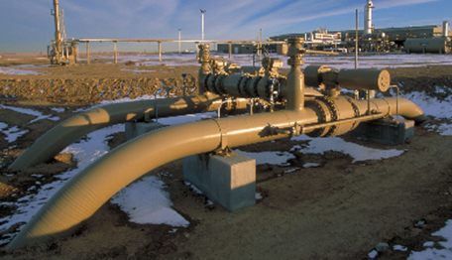
Business Challenges
An uncommanded or unplanned stop is a halt in the line delivery or pumping process not due to specific planned purpose
Frequent uncommanded shut downs can result in
Overtime to respond to unplanned events and safety risks
Higher equipment wear and equipment costs
Lost revenue due to lower throughput
Customer confidence/service issues

Slide 58

Top influencing factors of Uncommanded Stops
Weather effects are drivers for ESD
Most influencing
1) Precipitation larger than a 0.05 Inch
Insights
2) Humidity above 81%
Rain, Humidity and Wind play a major role in causing uncommanded stops
Earthquakes, season, and lighting are not a significant contributor to uncommanded stops
3) Gust Speed above 16 MPH
4) Wind Degrees (North East Wind)
5) Sea Level Pressure above 30 inHG
6) Flash Flood
Least influencing
Please check appendix for statistical details

